Slide 1
Algorithms Analysis and Design
Notes:
To create Em dash above headline:
Same size and weight as the headline and set using a soft return.
PC: Em dash (—): Alt+Ctrl+ - (minus)
Mac: Em dash (—): Shift+Alt/Option+hyphen

Slide 2
Agenda
Overview
Analysis of Time Efficiency
Asymptotic Complexity
Analyzing Non-recursive Algorithms
Analyzing Recursive Algorithms
Empirical Analysis
Summary

Slide 3
1. Overview
Notes:
To create Em dash above headline:
Same size and weight as the headline and set using a soft return.
PC: Em dash (—): Alt+Ctrl+ - (minus)
Mac: Em dash (—): Shift+Alt/Option+hyphen

Slide 4
Learning objectives
Understand why it is important to be able to compare the complexity of algorithms
Be able to:
Measure complexity of algorithms and compare complexity classes
Analysis of non-recursive algorithms
Analysis of recursive algorithms
Be able to perform empirical analyses of algorithms

Slide 5
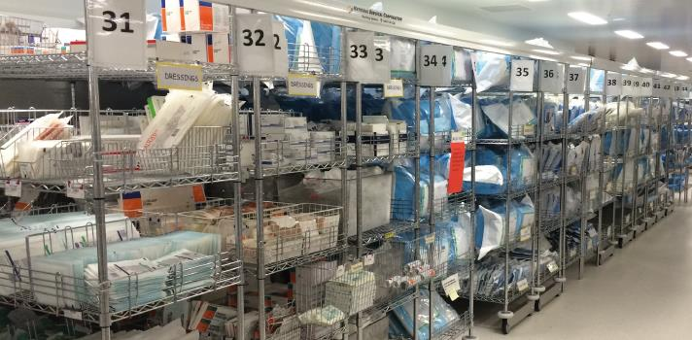
Example: Which is faster?
Scenario: You work for a small medicine stocker. Your boss comes and asks your opinion on which of two approaches is faster for employees to search over an unordered set of medicines.
Question: Which of the following two approaches will you tell your boss is faster?
Solution A: Search one by one.
Solution B: Sort then search.

Slide 6
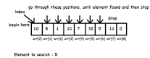
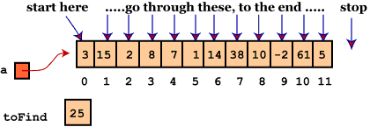
Array Search
Items Average number of tries
10 5
100 50
1000 500
10,000 5000
100,000 50,000
1,000,000 500,000
10,000,000 5,000,000
For a non-sorted array of size N, the number of tries to find a value is correlated to N

Slide 7
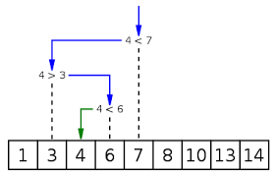
Binary Search
Items Tries
10 4
100 7
1000 10
10,000 14
100,000 17
1,000,000 20
10,000,000 24
For a sorted array of size N, the number of tries to find a value is correlated to log₂N

Slide 8
Comparing Performance
Different algorithms that solve the same problem can have very different performance
How do we compare the time efficiency of two programs that solve the same problem?
Run them and compare their time requirements
Need address issues such as - what computer to use, what data to use and how much space is needed?
An inefficient algorithm on a small data set e.g. one that grows quadratically, would be unfeasible to run on a large data set

Slide 9
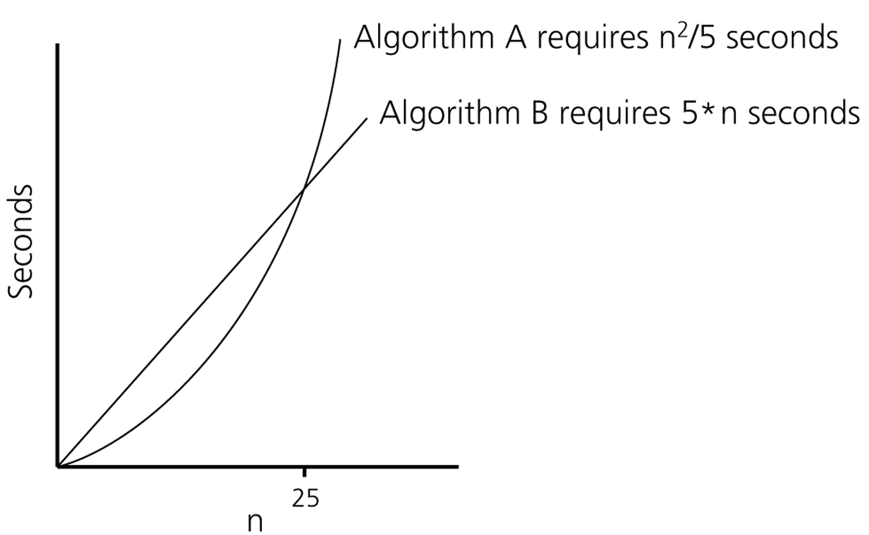
Program Performance
Assume that we can find a formula that, for a specific machine, determines how long a program takes to run on various input (N) sizes
When do programs A and B become impractical?
If n = 10 then A takes 20 and B takes 50 secs
If n = 25 they both take 125 secs.
If n = 10³ then A takes 200,000 secs and B takes 5,000 secs.
If n = 10⁶ then A takes 2x10¹¹ seconds and B take 5x10⁶ seconds
Algorithmic performance is critical when analyzing large data sets

Slide 10
Example: Which is faster?
In this lecture, we look at the ways of estimating the running time of a program and how to compare the running times of two programs without ever implementing them
It is vital to analyse the resource use of an algorithm, well before it is implemented and deployed
Space is also important but we focus on time in this course

Slide 11
2. Analysis of Time Efficiency

Slide 12
How to estimate running time?
How do we estimate the running time of an algorithm?
When we analyze algorithms, we should employ mathematical techniques that analyze algorithms independently of specific implementations, computers or data
To analyze algorithms:
First, we start to count the number of significant operations in a particular solution to assess its efficiency
Then, we will express the efficiency of algorithms using growth functions

Slide 13
Theoretical Analysis of Time Efficiency
Idea: An algorithm consists of some operations executed a number of times.
Hence, an estimate of the running time/time efficiency of an algorithm can be obtained from
Determining these operations
How long to execute them, and
The number of times they are executed.
These operations are called basic operations and the number of times is based on the input size of the problem.
Notes:
How to estimate the running time of an algorithm?

Slide 14
Basic operation
Operation(s) that contribute most towards the total running time.
Examples:
Compare ( i != j )
Add ( i + j )
Multiply ( i * j )
Divide ( i / j )
Assignment ( i = j )

Slide 15
Execution Time of Algorithms - 1
Each operation in an algorithm (or a program) has a cost
➔ Each operation takes a certain of time.
count = count + 1; ➔ take a certain amount of time, but it is constant
A sequence of operations:
count = count + 1 Cost: c₁
sum = sum + count Cost: c₂
➔ Total Cost = c₁ + c₂

Slide 16
Execution Time of Algorithms - 2
Example: Simple If-Statement
Cost Occurrences
if (n < 0): c1 1
absval = -n c2 1
else:
absval = n c3 1
Total Cost <= c1 + max(c2,c3)

Slide 17
Execution Time of Algorithms - 3
Example: Simple Loop
Cost Occurrences
i = 1 ` c1 1
sum = 0 c2 1
while (i <= n): c3 n+1
i = i + 1 c4 n
sum = sum + i c5 n
Total Cost = c1 + c2 + (n+1)*c3 + n*c4 + n*c5

Slide 18
Execution Time of Algorithms - 4
Example: Nested Loop
Cost Occurrences
I = 1 c1 1
sum = 0 c2 1
while (i <= n): c3 n+1
j=1 c4 n
while (j <= n): c5 n*(n+1)
sum = sum + i c6 n*n
j = j + 1 c7 n*n
i = i +1 c8 n
Total Cost = c1 + c2 + (n+1)*c3 + n*c4 + n*(n+1)*c5+n*n*c6+n*n*c7+n*c8

Slide 19
General Rules for Estimation
Loops: The running time of a loop is at most the running time of the statements inside of that loop times the number of iterations.
Nested Loops: Running time of a nested loop containing a statement in the inner most loop is the running time of statement multiplied by the product of the sized of all loops.
Consecutive Statements: Just add the running times of those consecutive statements.
If/Else: Never more than the running time of the test plus the larger of running times of S1 and S2.

Slide 20
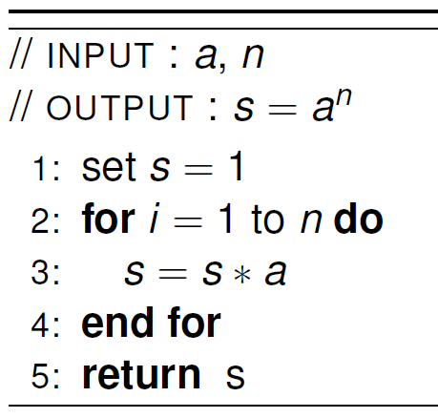
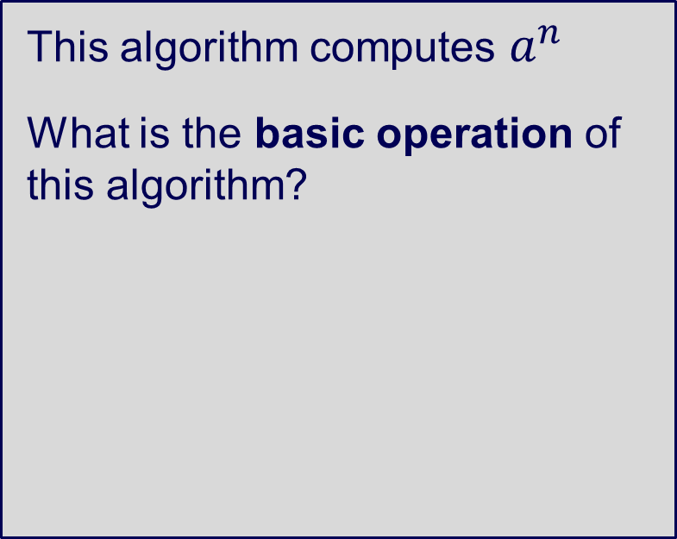
Basic operation
This algorithm computes $a^{n}$
What is the basic operation of this algorithm?
Notes:
Set s = 1
Set i = 1
Multiply and set

Slide 21
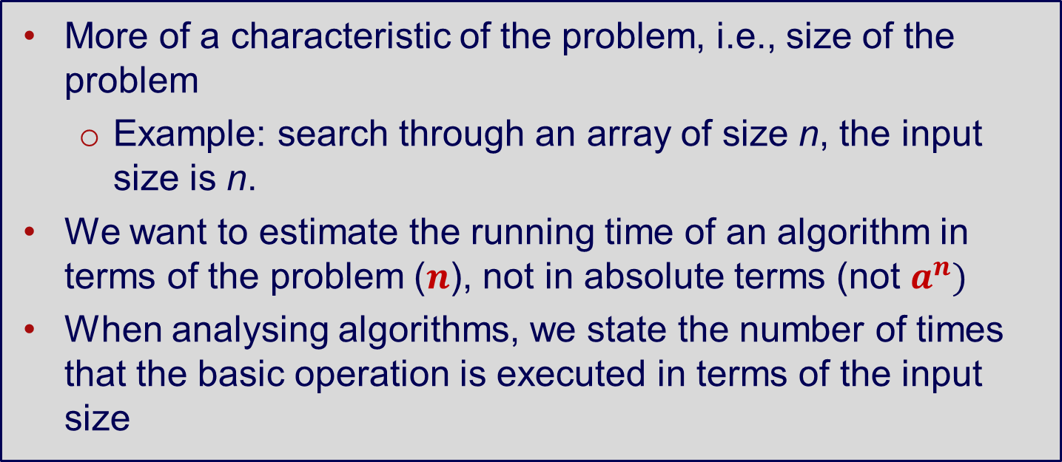
Input size
More of a characteristic of the problem, i.e., size of the problem
Example: search through an array of size n, the input size is n.
We want to estimate the running time of an algorithm in terms of the problem ($n$), not in absolute terms (not $a^{n})$
When analysing algorithms, we state the number of times that the basic operation is executed in terms of the input size

Slide 22
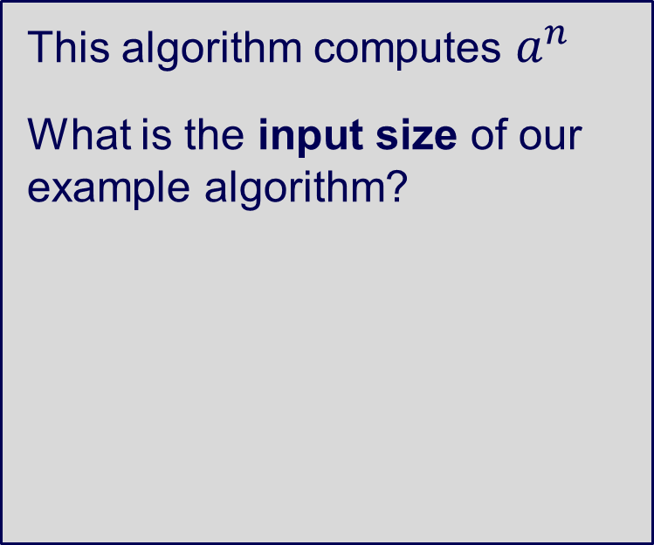
Input size
This algorithm computes $a^{n}$
What is the input size of our example algorithm?

Slide 23
Theoretical Analysis of Time Efficiency
With the basic operation and input size, how do we estimate the running time of an algorithm?
Running time approximates to
time to execute a basic operation x basic operations

Slide 24
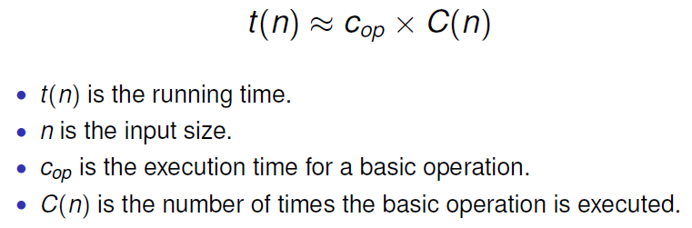
Theoretical Analysis of Time Efficiency

Slide 25
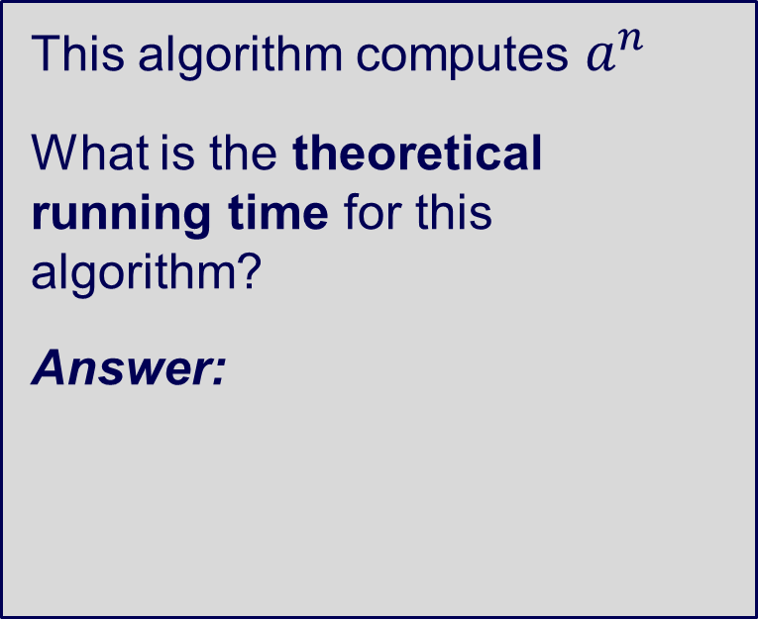
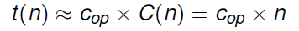
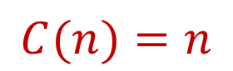
Theoretical Analysis of Time Efficiency
This algorithm computes $a^{n}$
What is the theoretical running time for this algorithm?
Answer:
$$C(n)=n$$
Notes:
C(n) = n (number of times basic operations executed)
What’s the value of Cop? Depends on your computer’s performance, can be in nanoseconds

Slide 26
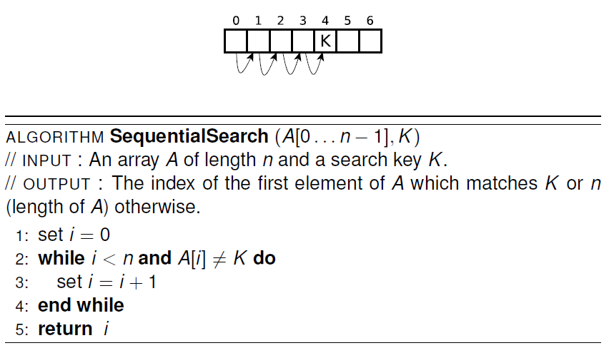
Example: Searching for a key in n items using Sequential Search

Slide 27
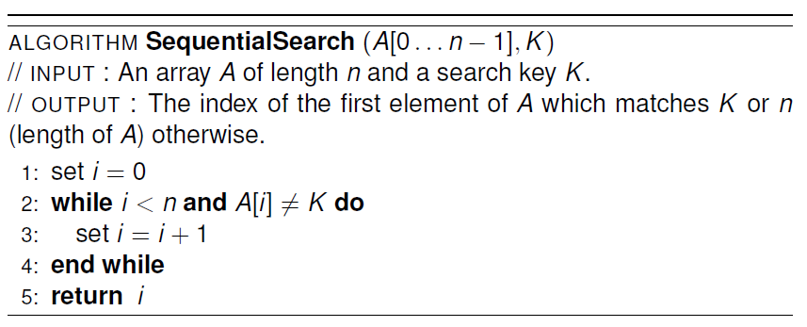
Example: Searching for a key in n items using Sequential Search
Basic operations?
Input size?
comparison, addition, assignment
n
What is the theoretical running time for Sequential Search?
Notes:
More difficult to determine

Slide 28
Runtime Complexity
Worst Case - Given an input of n items, what is the maximum running time for any possible input?
Best Case - Given an input of n items, what is the minimum running time for any possible input?
Average Case - Given an input of n items, what is the average running time across all possible inputs?
NOTE: Average Case is not the average of the worst and best case. Rather, it is the average performance across all possible inputs.

Slide 29
Runtime Complexity
Sequential Search: search for the key by traversing values in the array one-by-one
Best-case:
The best case input is when the item being searched for is the first item in the list, so C_{best} (n) = 1.
Worst-case:
The worst case input is when the item being searched for is not present in the list, so C_{worst} (n) = n.

Slide 30
Runtime Complexity
Average Case: What does average case mean?
Recall: average across all possible inputs – how to analyse this?
Typically not straight forward.

Slide 31
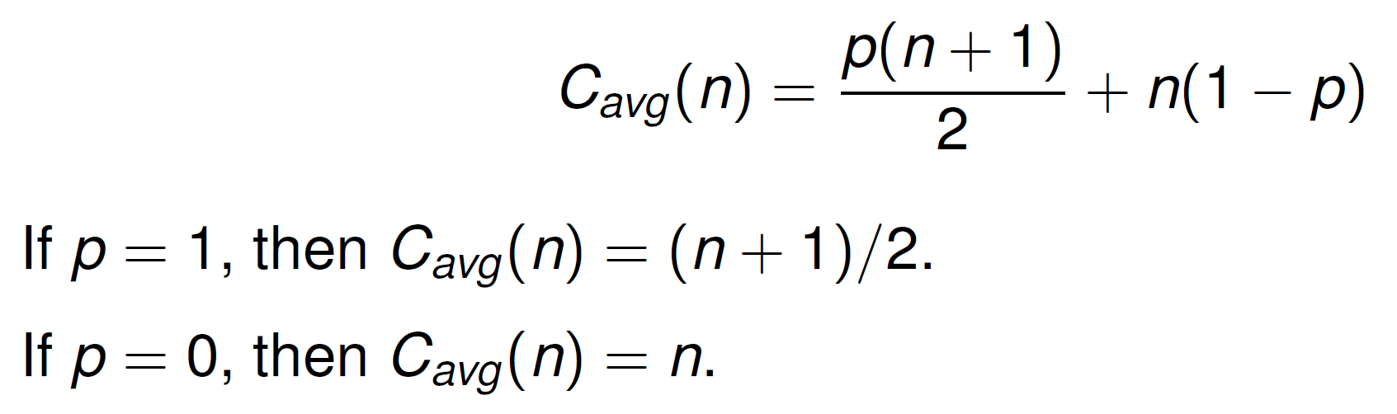
Runtime Complexity
Average Case Analysis: p is the probability of a successful search.

Slide 32
Summary for this part
Input size, basic operation
Time complexity estimate using input size and basic operation
Best, worst, and average cases

Slide 33
3. Asymptotic Complexity

Slide 34
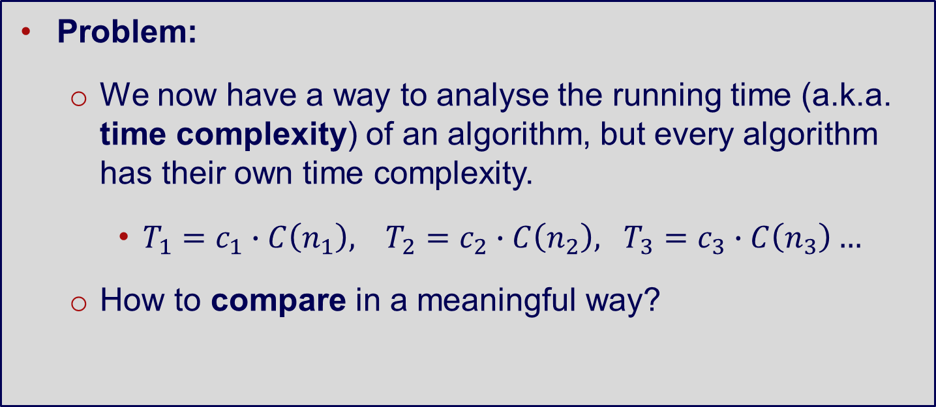
Asymptotic Complexity
Problem:
We now have a way to analyse the running time (a.k.a. time complexity) of an algorithm, but every algorithm has their own time complexity.
$T_{1}=c_{1}∙C\left(n_{1}\right), T_{2}=c_{2}∙C\left(n_{2}\right), T_{3}=c_{3}∙C\left(n_{3}\right)…$
How to compare in a meaningful way?

Slide 35
Asymptotic Complexity
Solution:
Group them into equivalence classes (for easier comparison and understanding), with respect to the input size
Focus of this part: asymptotic complexity and equivalence classes

Slide 36
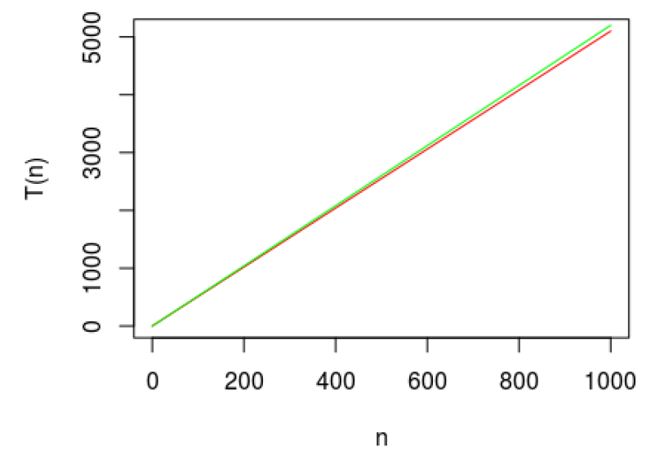
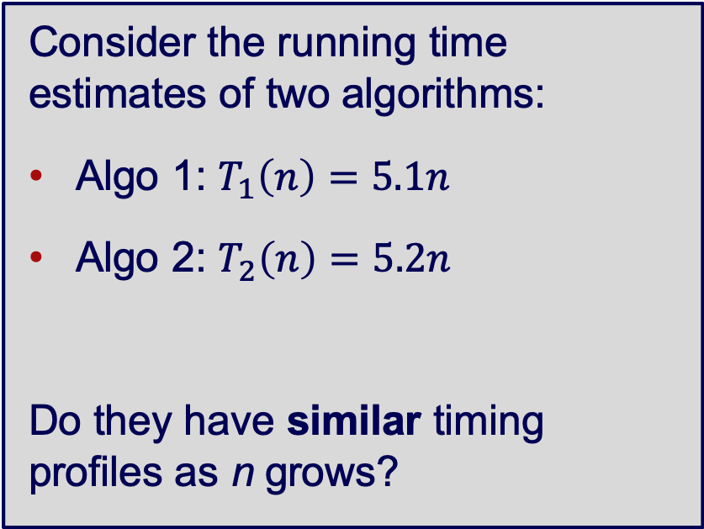
Asymptotic Complexity
Consider the running time estimates of two algorithms:
Algo 1: $T_{1}\left(n\right)=5.1n$
Algo 2: $T_{2}\left(n\right)=5.2n$
Do they have similar timing profiles as n grows?

Slide 37
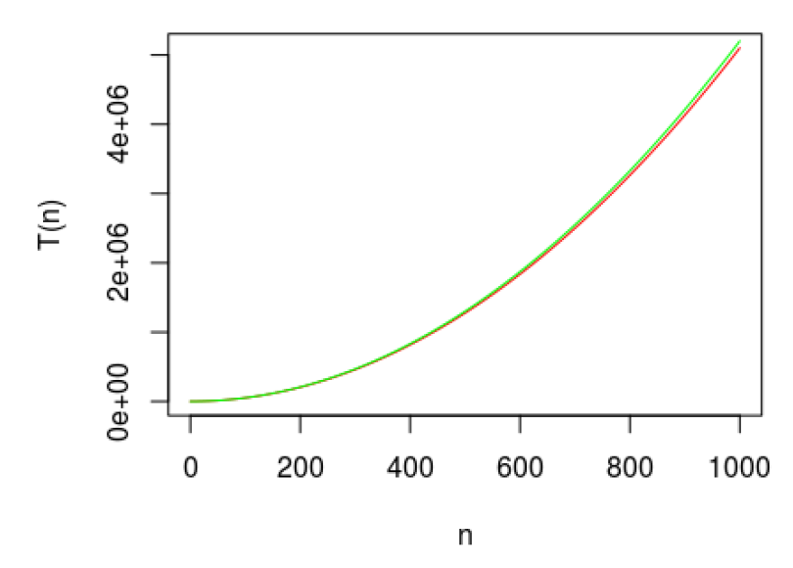
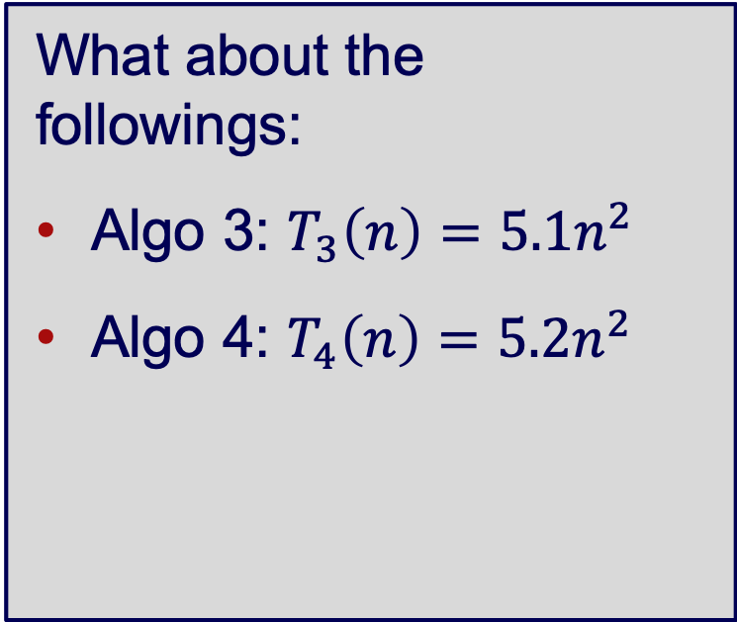
Asymptotic Complexity
What about the followings:
Algo 3: $T_{3}\left(n\right)=5.1n^{2}$
Algo 4: $T_{4}\left(n\right)=5.2n^{2}$

Slide 38
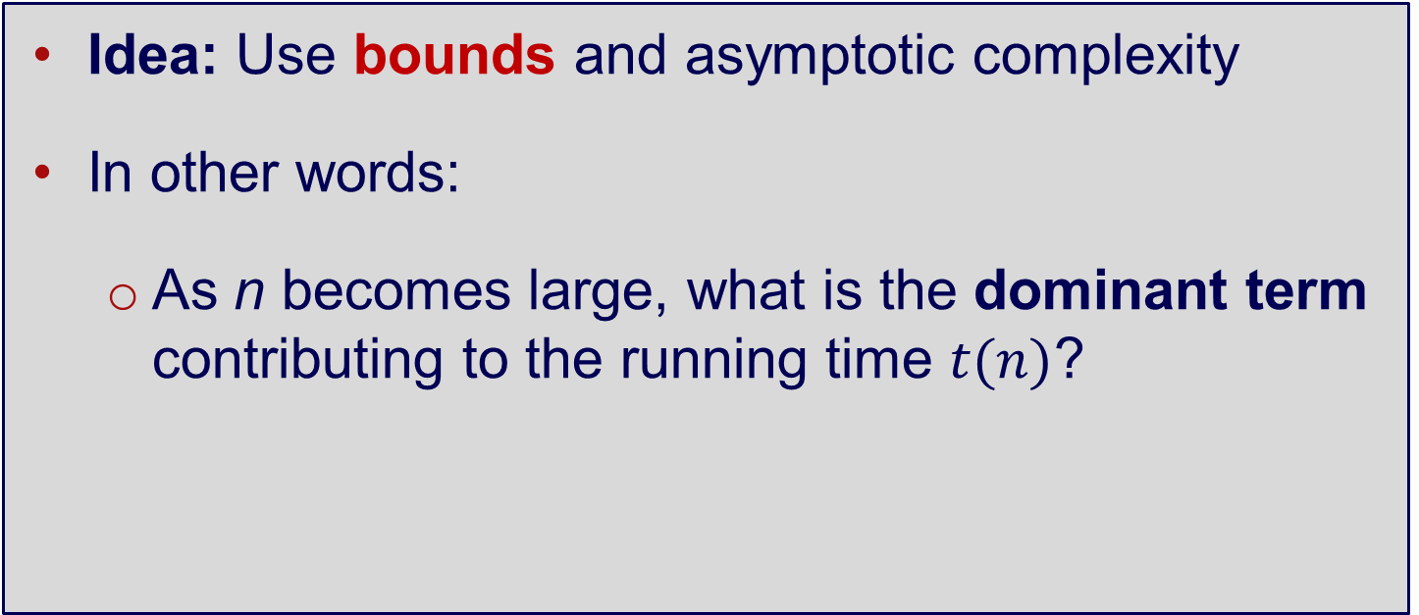
Asymptotic Complexity - Bounds
Idea: Use bounds and asymptotic complexity
In other words:
As n becomes large, what is the dominant term contributing to the running time $t(n)$?

Slide 39
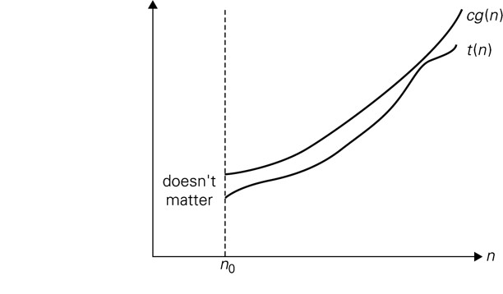
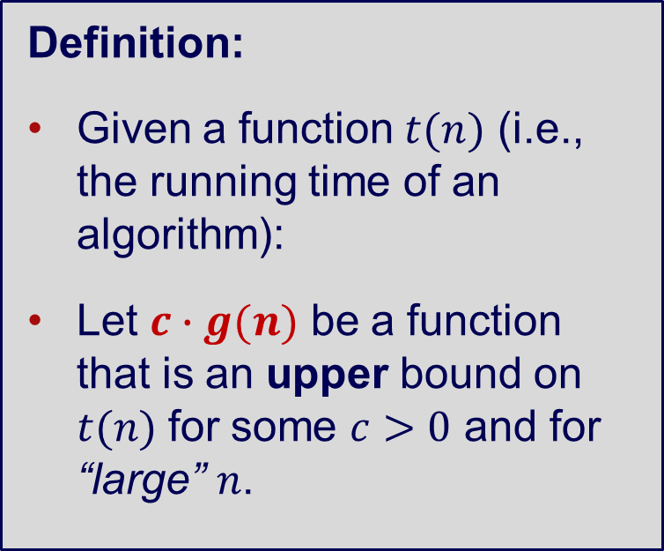
Asymptotic Complexity - Upper bounds
Definition:
Given a function $t(n)$ (i.e., the running time of an algorithm):
Let $c∙g(n)$ be a function that is an upper bound on $t(n)$ for some $c>0$ and for “large” $n$.
Notes:
C = time to run a basic operation

Slide 40
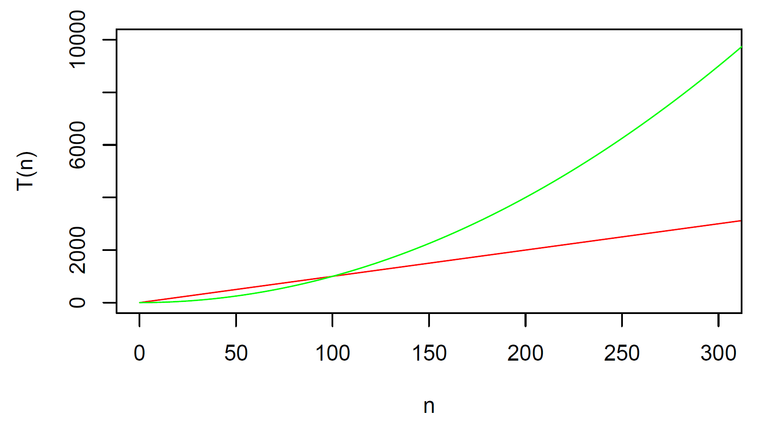
Example: Upper Bounds

Slide 41
Asymptotic Complexity – O(n)
Rather than talking about individual upper bounds for each running time function, we seek to group them into equivalence classes that describe their order of growth.
Big-O notation: O(n)

Slide 42
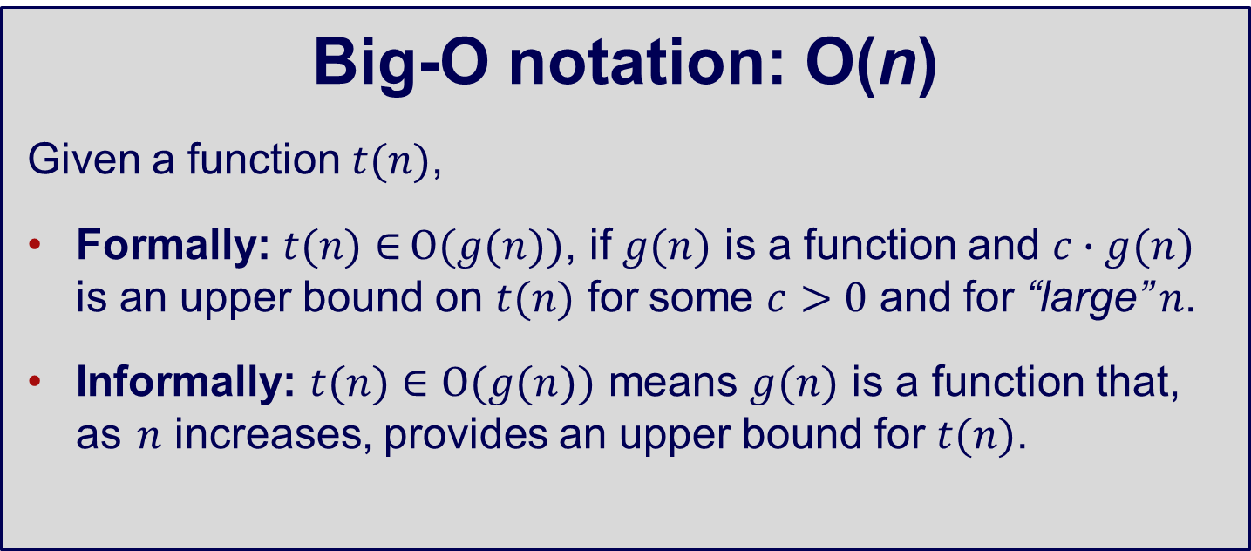
Asymptotic Complexity – O(n)
Big-O notation: O(n)
Given a function $t(n)$,
Formally: $t(n)∈O(g(n))$, if $g(n)$ is a function and $c∙g(n)$ is an upper bound on $t(n)$ for some $c>0$ and for “large” $n$.
Informally: $t(n)∈O(g(n))$ means $g(n)$ is a function that, as $n$ increases, provides an upper bound for $t(n)$.

Slide 43
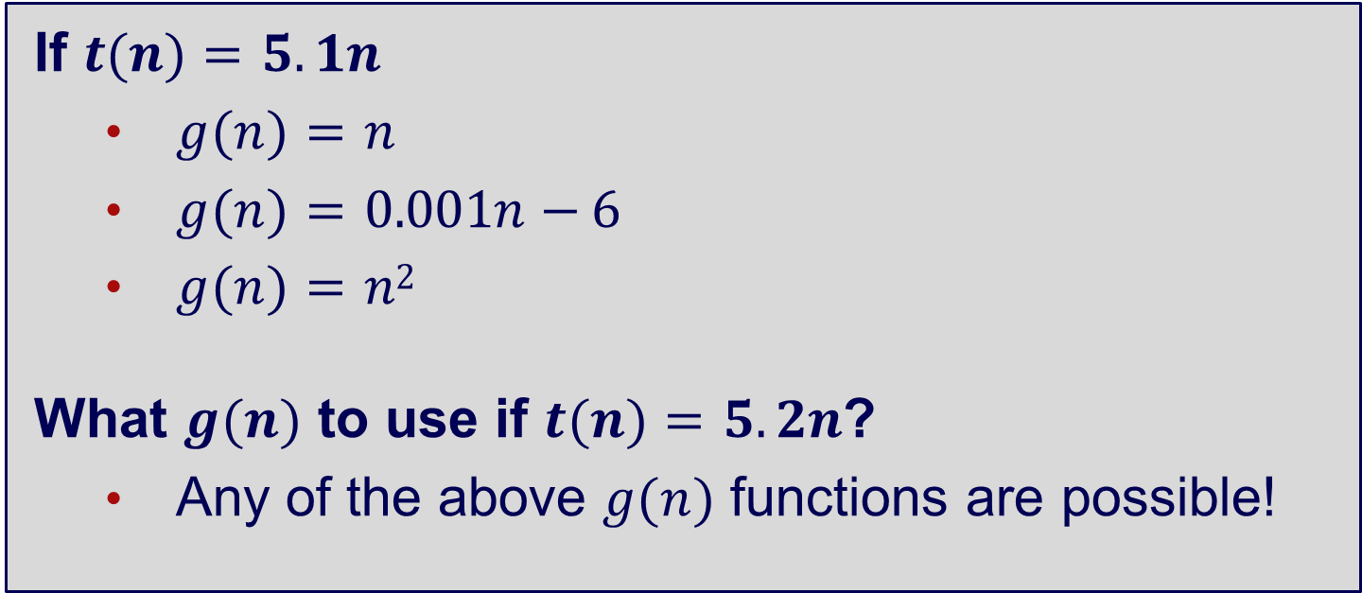
Asymptotic Complexity – O(n)
If $t(n)=5.1n$
$g(n)=n$
$g(n)=0.001n−6$
$g(n)=n2$
What $g(n)$ to use if $t(n)=5.2n$?
Any of the above $g(n)$ functions are possible!

Slide 44
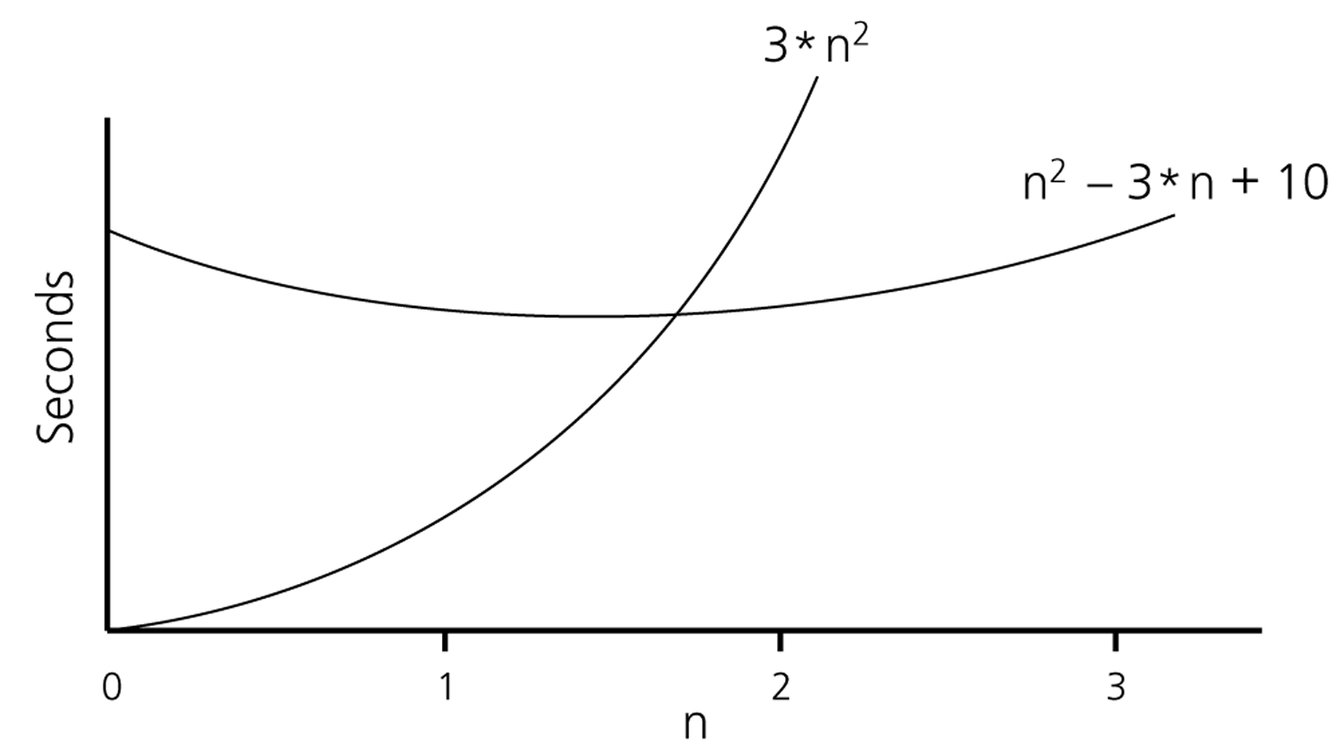
Asymptotic Complexity - Example
If an algorithm requires n²–3*n+10 seconds to solve a problem size n if constants k and n₀ exist such that
k*n² > n²–3*n+10 for all n ≥ n₀
the algorithm is order n² (In fact, k is 3 and n₀ is 2)
3*n² > n²–3*n+10 for all n ≥ 2
Thus, the algorithm requires no more than
k*n² time units for n ≥ n₀ where k = 3 and n_{o} = 2
So it is O(n²)

Slide 45
Common Equivalence Classes
O(1) Constant, (access array element)
O(log₂n) Logarithmic (binary search)
O(n) Linear (finding maximum in an array)
O(nlog₂n) Linearithmic (best sorting algorithms such as merge sort, FFT)
O(n²) Quadratic (simple sorting algorithms)
O(n³) Cubic (matrix multiplication)
NP Non polynomial (travelling salesman, open problem “P=NP”)
O(2^{n}) Exponential (best known algorithm for travelling salesman, generating all
subsets of N elements, number of disks moved to solve the tower of Hanoi)
O(N!) Factorial – generating all permutations of N elements
List sorted from best to worst. Many other options e.g. sqrt(n), log(log(n)), etc.

Slide 46
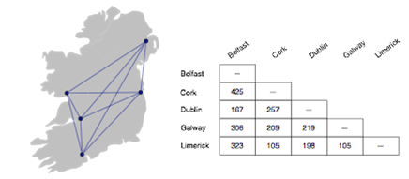
Bike Tour
Suppose you decide to ride a bicycle around Ireland
You will start in Dublin and your goal is to visit Cork, Galway, Limerick, and Belfast before returning to Dublin
What is the best itinerary?
How can you minimize the number of kilometers yet make sure you visit all the cities?

Slide 47
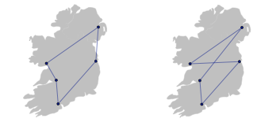
Optimal Tour
If there are only 5 cities it’s not too hard to figure out the optimal tour
The shortest path is most likely a “loop”
Any path that crosses over itself will be longer than a path that travels in a big circle

Slide 48
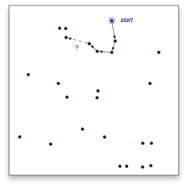
Increasing the Number of Cities
As we add cities to our tour, however, it is much harder to figure out the optimal tour
A simple strategy of going to the closest city does not always lead to the shortest tour
This example has 25 cities
After visiting 4 cities, where would you go next?
Going to this city does not lead to the shortest tour...

Slide 49
Is Exhaustive Search Possible?
One option is to do an exhaustive search, but
Number of possible tours of a map with n cities is (n − 1)! / 2
n! is the product n × (n − 1) × (n − 2) ... × 2 × 1
The number of tours grows incredibly quickly as we add cities to the map
#Cities | #Tours
5 | 12
6 | 60
7 | 360
8 | 2,520
9 | 20,160
10 | 181,440
The number of tours for 25 cities:
310,224,200,866,619,719,680,000

Slide 50
Traveling Salesman Problem
Finding an optimal path between n points is known as the traveling salesman problem
Famous problem first posed by Irish mathematician W. R. Hamilton in the 19th century. Intensely studied in operations research and other areas since 1930
This is of the famous P=NP problems which are problems that can be quickly verified (in polynomial time) can also be solved quickly (in polynomial time)
TSP, Boolean satisfiability, knapsack, tiling, graph coloring
Proof would have profound implications for mathematics, cryptography, AI, game theory,….
Number of Cities | Number of Steps
1 | 1
2 | 1
3 | 6
4 | 24
5 | 120
6 | 720
7 | 5,060
8 | 40,320
9 | 362,880
10 | 3,628,800
11 | 39,916,800
12 | 479,001,600
13 | 6,227,020,800

Slide 51
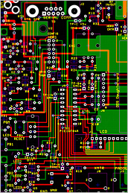
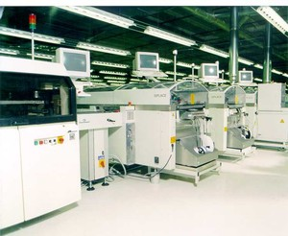
Real-Life Applications
It’s not likely anyone would want to plan a bike trip to 25 cities
But the solution of many important real-world problems is the same as finding a tour of a large number (n>1000) of cities
Transportation: school bus routes, service calls, delivering meals, ...
Manufacturing: an industrial robot that drills holes in printed circuit boards
VLSI (microchip) layout
Planning a telecom network

Slide 52
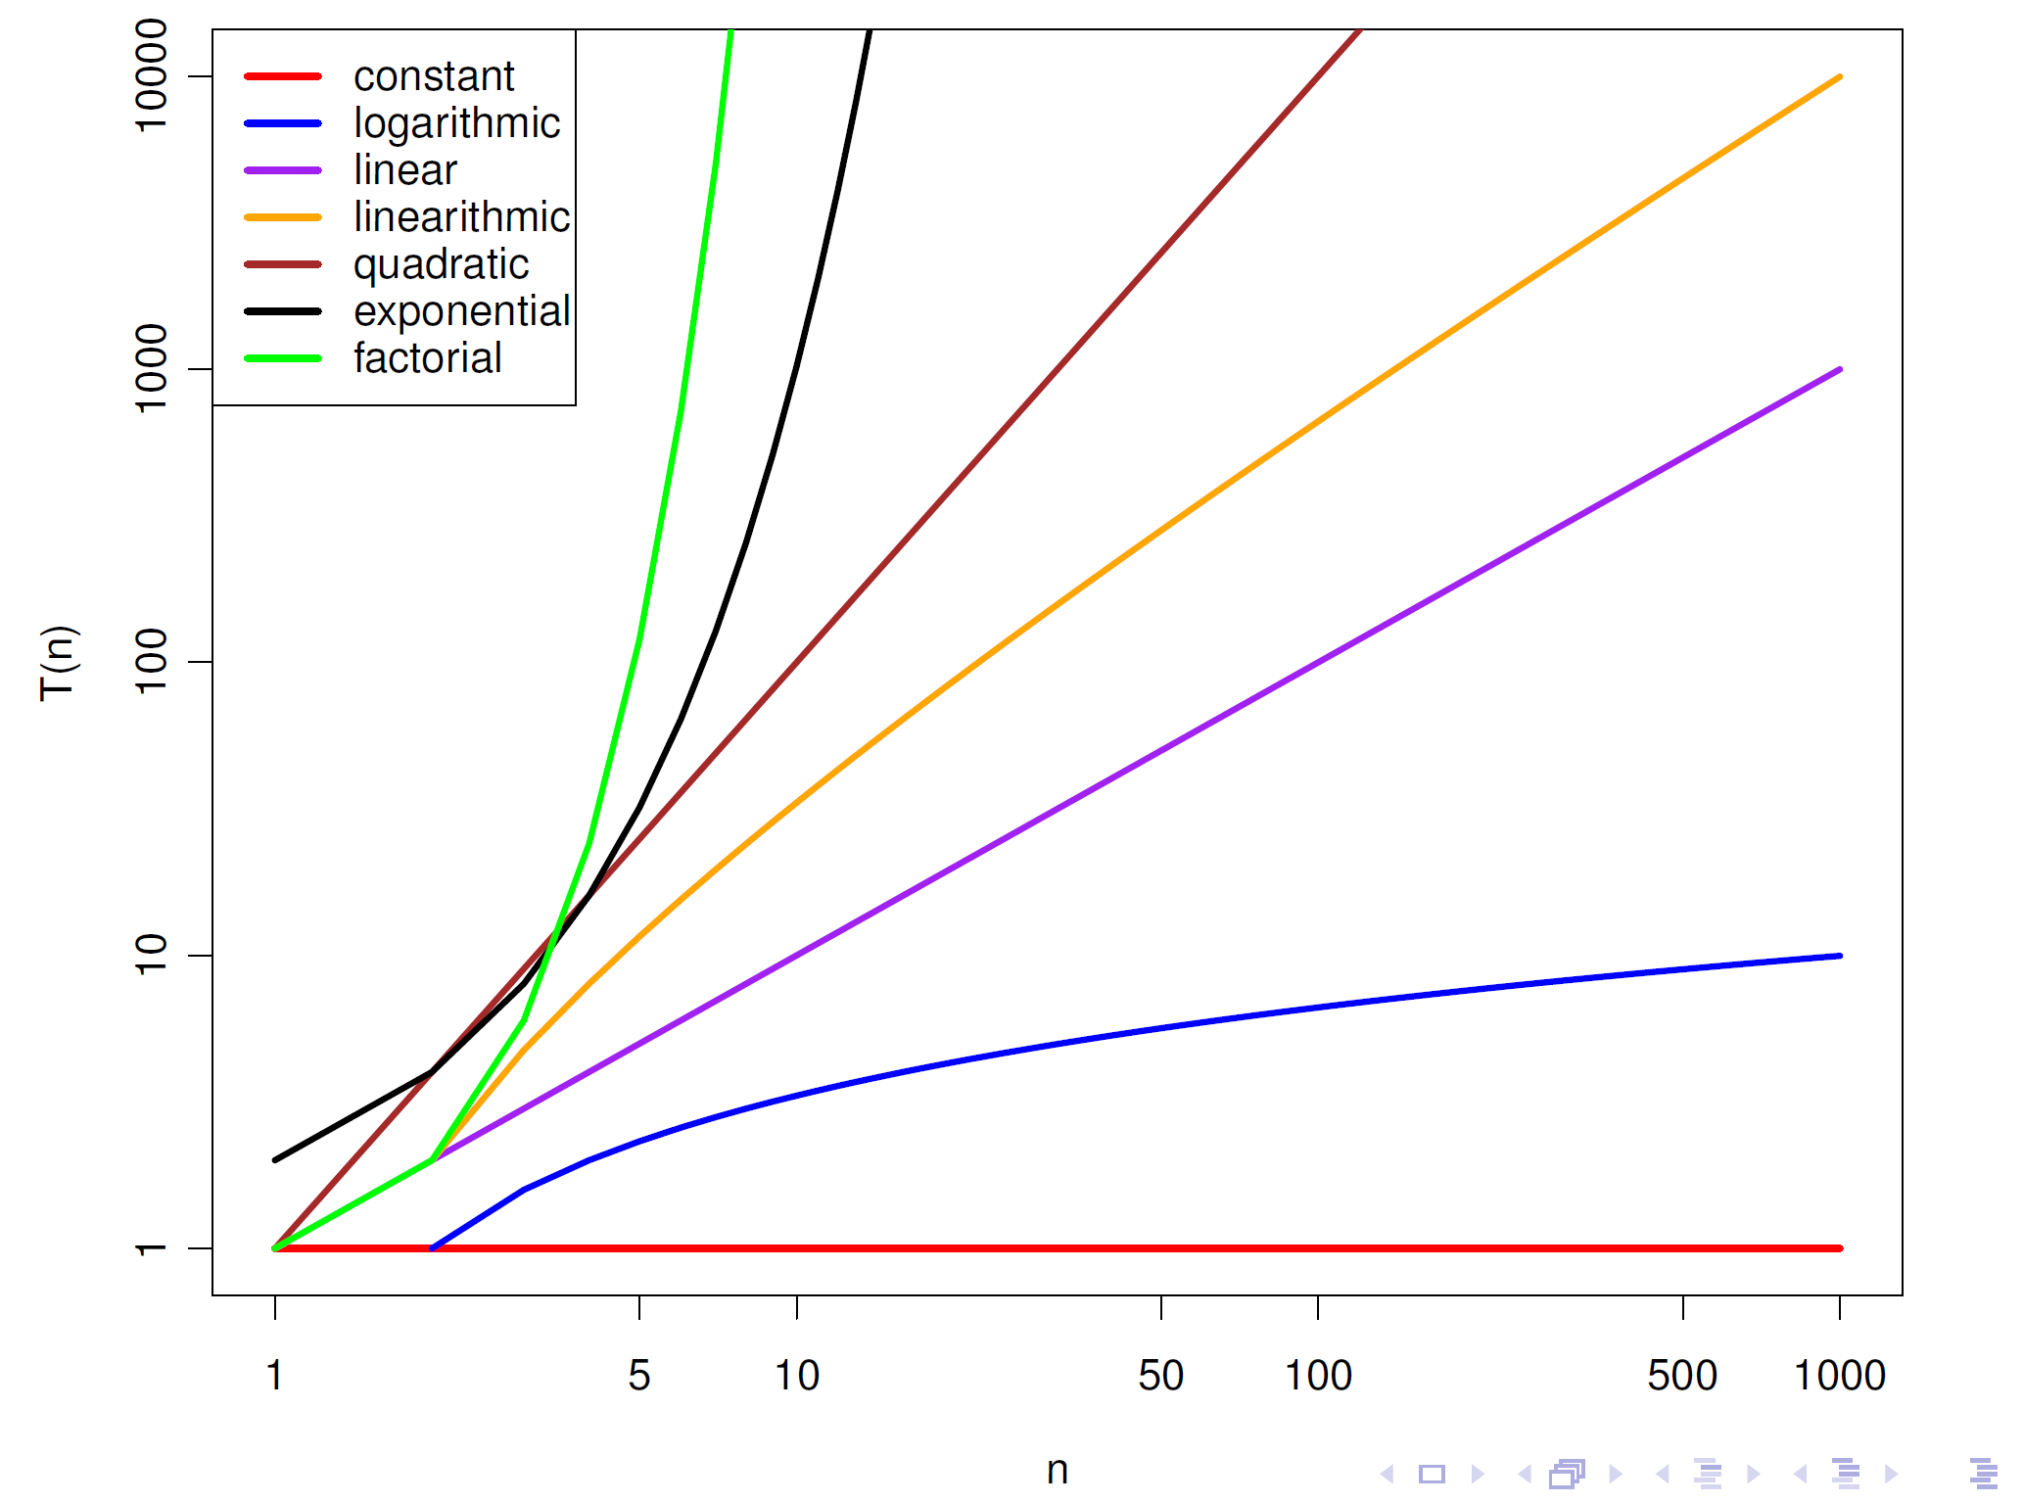
Common Complexity Bounds
Notes:
Previous slide, we had multiple upper bounds. But we can in fact group them to a smaller number. First we look at common equivalence classes:

Slide 53
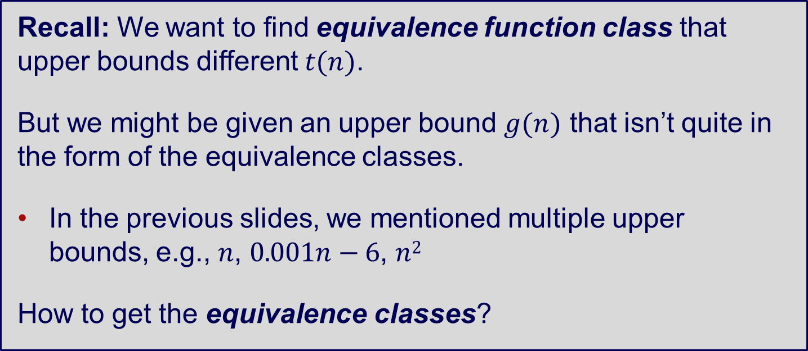
Common Complexity Bounds
Recall: We want to find equivalence function class that upper bounds different $t(n)$.
But we might be given an upper bound $g(n)$ that isn’t quite in the form of the equivalence classes.
In the previous slides, we mentioned multiple upper bounds, e.g., $n$, $0.001n−6$, $n2$
How to get the equivalence classes?
Notes:
Previous slide, we had multiple upper bounds. But we can in fact group them to a smaller number. First we look at common equivalence classes:
We have so many g(n)’s

Slide 54
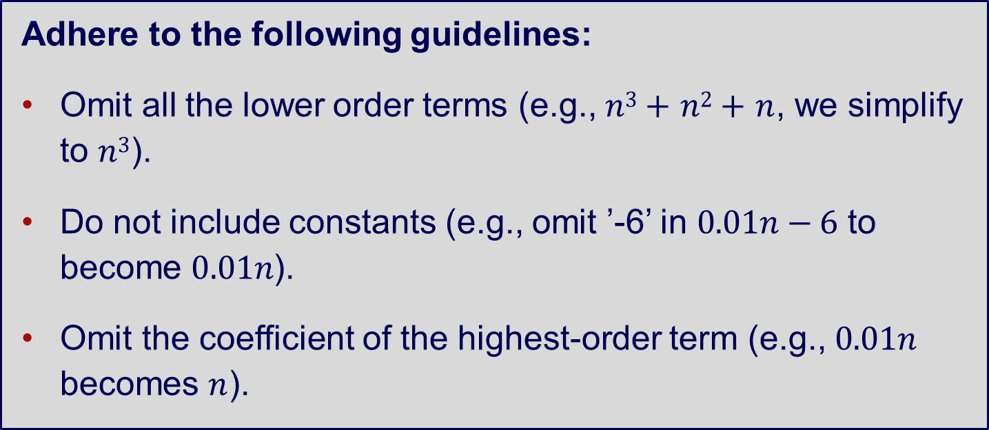
Common Complexity Bounds
Adhere to the following guidelines:
Omit all the lower order terms (e.g., $n3+n2+n$, we simplify to $n3$).
Do not include constants (e.g., omit ’-6’ in $0.01n−6$ to become $0.01n$).
Omit the coefficient of the highest-order term (e.g., $0.01n$ becomes $n$).
Notes:
Previous slide, we had multiple upper bounds. But we can in fact group them to a smaller number. First we look at common equivalence classes:

Slide 55
Growth-Rate Functions – Ex 1
Cost Occurrences
i = 1 c1 1
sum = 0 c2 1
while (i <= n): c3 n+1
i = i + 1 c4 n
sum = sum + i c5 n
T(n) = c1 + c2 + (n+1)*c3 + n*c4 + n*c5
= (c3+c4+c5)*n + (c1+c2+c3)
= a*n + b
➔ So, the growth-rate function for this algorithm is O(n)

Slide 56
Growth-Rate Functions – Ex 2
Cost Times
i=1 c1 1
sum = 0 c2 1
while (i <= n): c3 n+1
j=1 c4 n
while (j <= n): c5 n*(n+1)
sum = sum + i c6 n*n
j = j + 1 c7 n*n
i = i +1 c8 n
T(n) = c1 + c2 + (n+1)*c3 + n*c4 + n*(n+1)*c5+n*n*c6+n*n*c7+n*c8
= (c5+c6+c7)*n² + (c3+c4+c5+c8)*n + (c1+c2+c3) = a*n² + b*n + c
➔ So, the growth-rate function for this algorithm is O(n²)

Slide 57
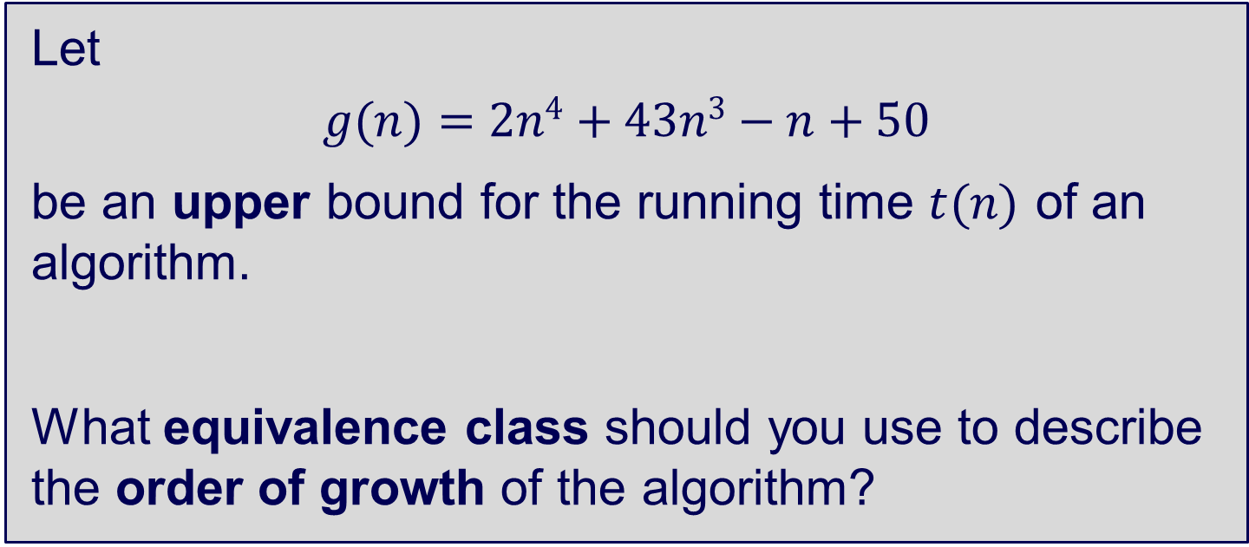
Common Complexity Bounds
Let
$$g(n)=2n4+43n3−n+50$$
be an upper bound for the running time $t(n)$ of an algorithm.
What equivalence class should you use to describe the order of growth of the algorithm?
Notes:
Previous slide, we had multiple upper bounds. But we can in fact group them to a smaller number. First we look at common equivalence classes:

Slide 58
Growth-Rate Functions
We can ignore low-order terms in an algorithm’s growth-rate function
If an algorithm is O(n³+4n²+3n), it is also O(n³)- We only use the higher-order term as algorithm’s growth-rate function
We can ignore a multiplicative constant in the higher-order term of an algorithm’s growth-rate function.
If an algorithm is O(5n³), it is also O(n³).
O(f(n)) + O(g(n)) = O(f(n)+g(n))
We can combine growth-rate functions
If an algorithm is O(n³) + O(4n), it is also O(n³ +4n²) ➔ So, it is O(n³).
Similar rules hold for multiplication

Slide 59
Growth Rate Functions
If an algorithm takes 1 second to run with the problem size 8, what is the time requirement (approximately) for that algorithm with the problem size 16?
If its order is:
O(1) T(n) = 1 second
O(log₂n) T(n) = 1*log₂16 / log₂8 = 4/3 seconds
O(n) T(n) = 1*16 / 8 = 2 seconds
O(n*log₂n) T(n) = 1*16*log₂16 / 8*log₂8 = 8/3 seconds
O(n²) T(n) = 1*16² / 8² = 4 seconds
O(n³) T(n) = 1*16³ / 8³ = 8 seconds
O(2^{n}) T(n) = 1*2¹⁶ / 2⁸ = 2⁸ seconds = 256 seconds

Slide 60
Other Types of Bounds?
So we talked about Big O notation for upper bounds…
What about other types of bounds?

Slide 61
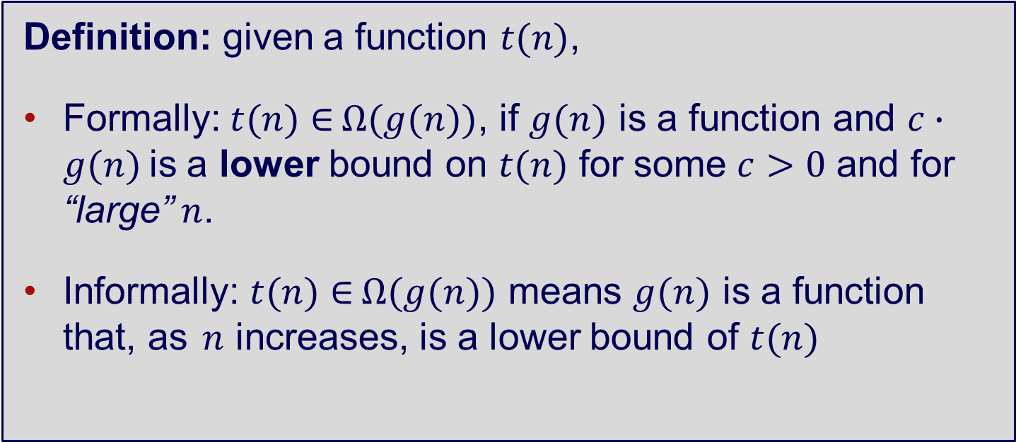
Lower Bound – Ω(n)
Definition: given a function $t(n)$,
Formally: $t(n)∈Ω(g(n))$, if $g(n)$ is a function and $c∙g(n)$ is a lower bound on $t(n)$ for some $c>0$ and for “large” $n$.
Informally: $t(n)∈Ω(g(n))$ means $g(n)$ is a function that, as $n$ increases, is a lower bound of $t(n)$

Slide 62
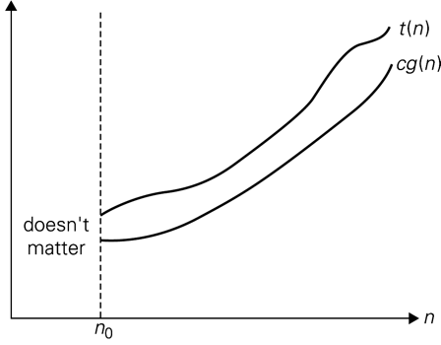
Lower Bound – Ω(n)

Slide 63
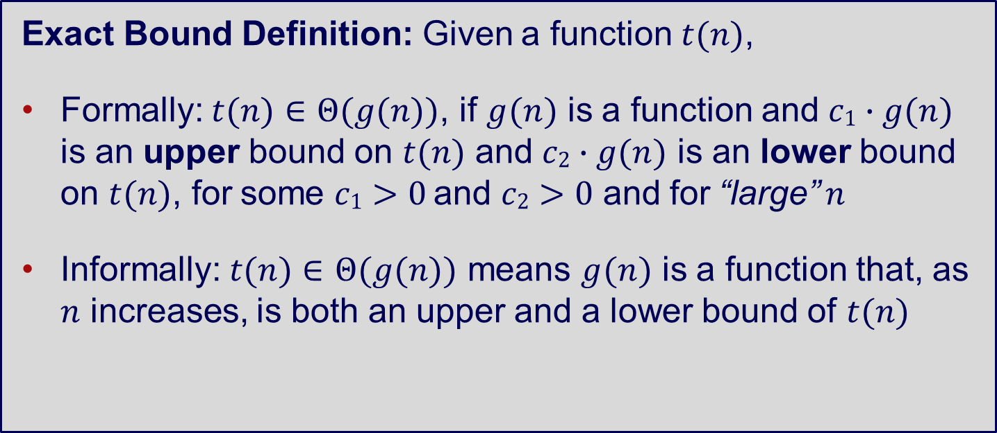
Exact Bounds – Θ(n)
Exact Bound Definition: Given a function $t(n)$,
Formally: $t(n)∈ Θ(g(n))$, if $g(n)$ is a function and $c1∙g(n)$ is an upper bound on $t(n)$ and $c2∙g(n)$ is an lower bound on $t(n)$, for some $c1>0$and $c2>0$ and for “large” $n$
Informally: $t(n)∈ Θ(g(n))$ means $g(n)$ is a function that, as $n$ increases, is both an upper and a lower bound of $t(n)$

Slide 64
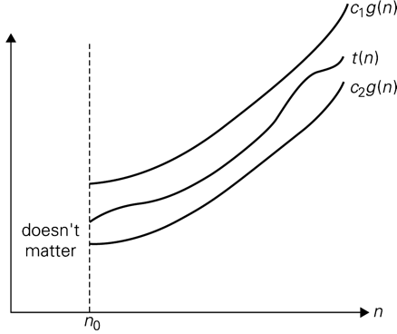
Exact Bounds – Θ(n)

Slide 65
Examples
 | Upper bound |  |  | Lower bound
t (n) | O(n) | O(n²) | O(n³) | Ω(n) | Ω(n²) | Ω(n³)
log₂ n | T | T | T | F | F | F
10n + 5 | T | T | T | T | F | F
n(n − 1)/2 | F | T | T | T | T | F
(n + 1)³ | F | F | T | T | T | T
₂n | F | F | F | T | T | T

Slide 66
Some clarifications…
Generally O(n) is most commonly used…
But exact bounds Θ(n) tell us the bounds are tight and the algorithm doesn’t have anything outside what we expect.
Lower bounds Ω(n) are useful to describe the (theoretical) limits of whole classes of algorithms, and also sometimes useful to state how fast can the best case reach.

Slide 67
Some clarifications…
O(n) is not the same thing as “Worst Case Efficiency”.
Ω(n) is not the same thing as “Best Case Efficiency”.
Θ(n) is not the same thing as “Average Case Efficiency”.
However, it is perfectly reasonable to want the Ω(n) and O(n) worst case efficiency bounds for a class of algorithms.

Slide 68
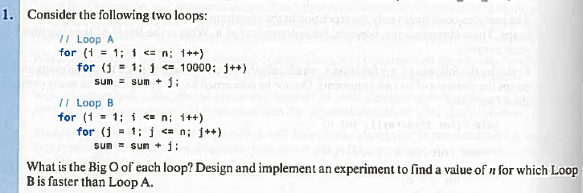
Questions

Slide 69
More Questions
What is the complexity of an algorithm that merges two sorted arrays so that the resultant array is also sorted. For example, if A = [3, 6, 10, 15] and B = [7, 10, 12, 19, 25], the result would be [3, 6, 7, 10, 10, 12, 15, 19, 25].
Describe an algorithm that can calculate a^{n} in O(log n)
Describe an algorithm to climb n stairs in O(n²)
Generate the approximation formula of an algorithm that runs as follows and verify that when N = 40 then T= 1100
N = 10, T = 201
N = 20, T = 499
N = 30, T = 799

Slide 70
4. Analysis of Non-recursive Algorithms

Slide 71
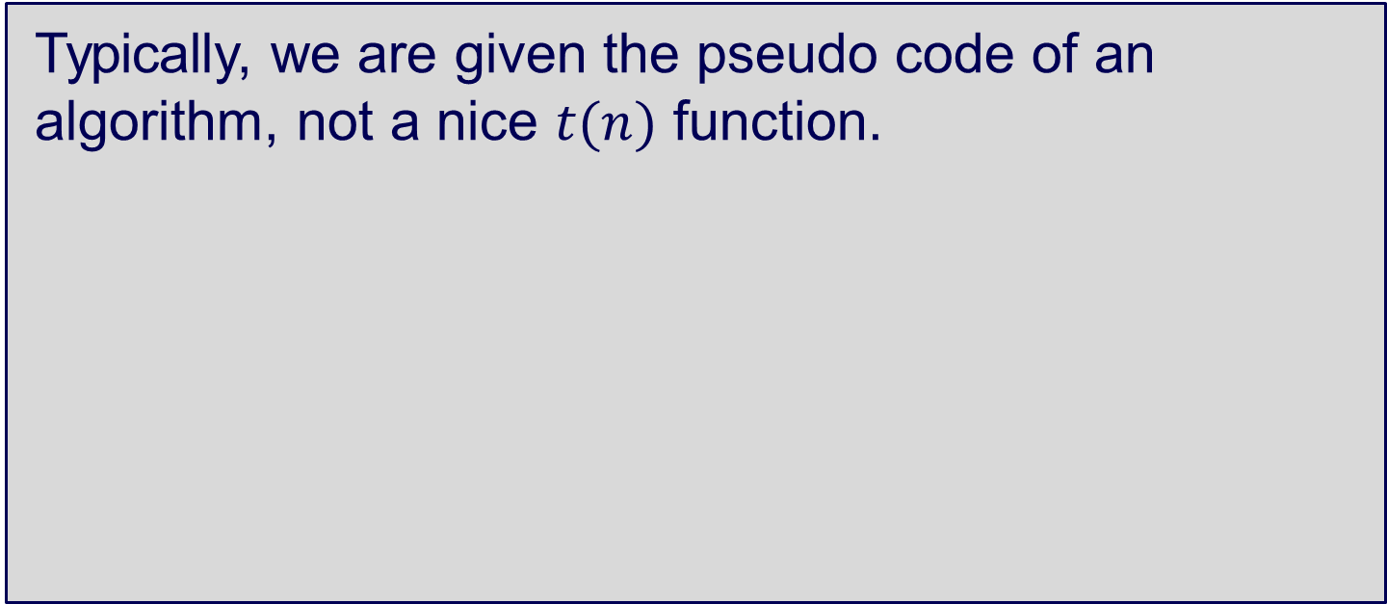
Time Efficiency of Algorithms
Typically, we are given the pseudo code of an algorithm, not a nice $t(n)$ function.
So how do we determine bounds on the order of growth of an algorithm?

Slide 72
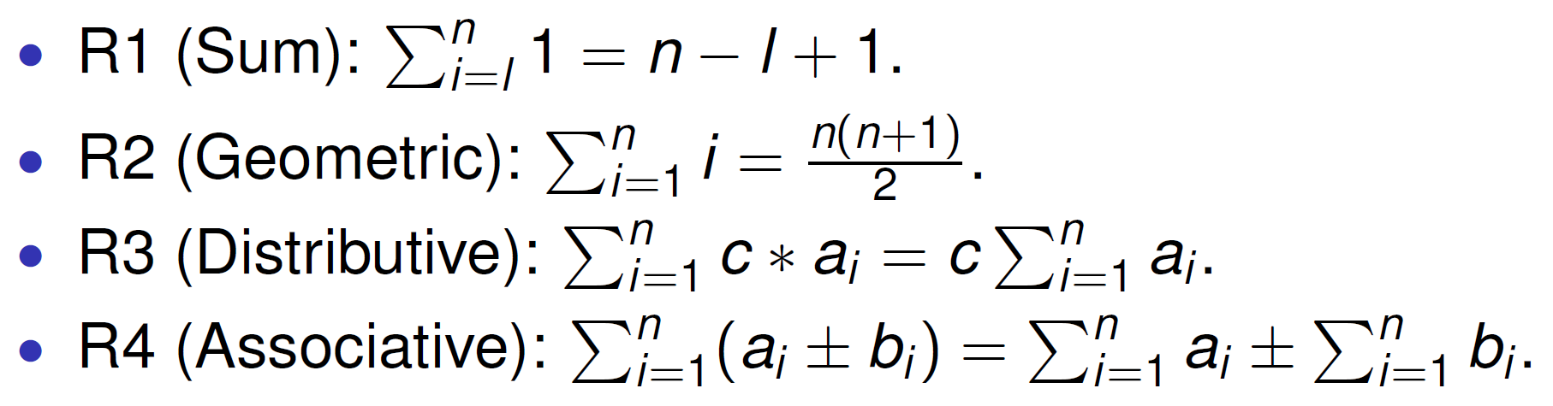
Summation Formulas
Source: Anany Levitin. Introduction to the Design and Analysis of Algorithms (course is following the 3rd Ed), Pearson, 2011.

Slide 73
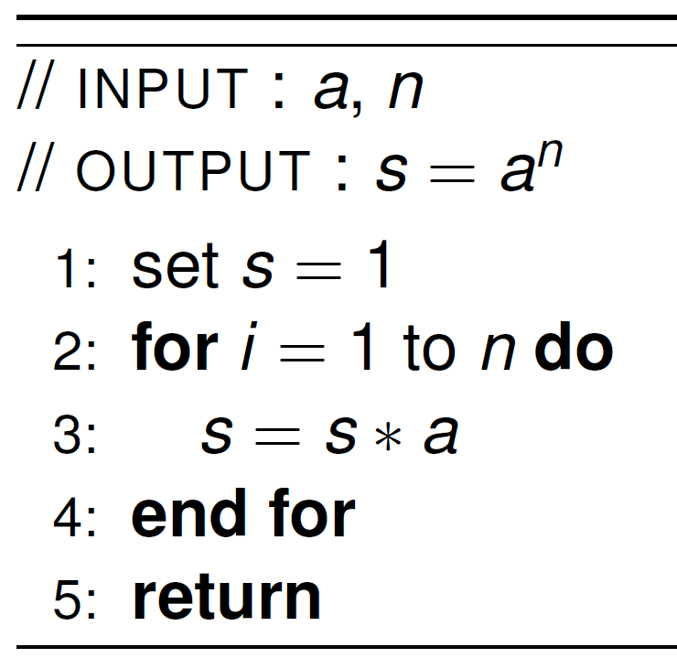
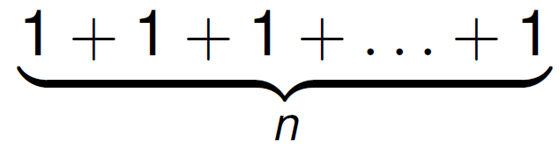
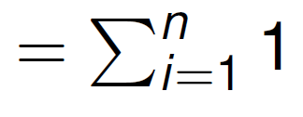
Non-recursive Example: a^{n}
n
Input size:
Basic operation:
C(n):
multiplication

Slide 74
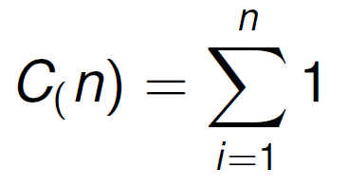
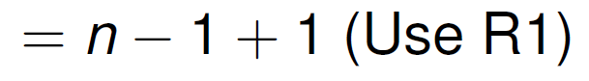
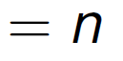
Non-recursive Example: a^{n}

Slide 75

Example: Adding Matrices
Given two (square) matrices A and B, both of dimensions n by n, the following algorithm computes C = A + B.
for (int i = 0; i <= n−1; i++) {
for (int j = 0; j <= n−1; j++) {
C[i, j] = A[i, j] + B[i, j];
}
}
n
Input size:
Basic op.:
C(n):
addition

Slide 76
Adding Matrices
Given two (square) matrices A and B, both of dimensions n by n, the following algorithm computes C = A + B.
for (int i = 0; i <= n−1; i++) {
for (int j = 0; j <= n−1; j++) {
C[i, j] = A[i, j] + B[i, j];
}
}
C(n):

Slide 77





Adding Matrices

Slide 78
Estimate Time Efficiency
Sometimes, you have to calculate everything step-by-step
In practice, understanding what the algorithms do may indicate the bounds of the algorithms
For example: traversing each column per row requires a nested loop → O(n²)

Slide 79
5. Analysis of Recursive Algorithms

Slide 80
Recursion
Recursion is fundamental tool in computer science.
A recursive program (or function) is one that calls itself.
It must have a termination condition defined.
Many interesting algorithms are simply expressed with a recursive approach.

Slide 81

Recurrence Relations
A recurrence relation represents a sequence of terms, that results from a recursion on one or more of the previous terms.
The recurrence relation include the termination condition.
For example, the sequence for a factorial of n:
$$F (n)=n∗(n−1)∗(n−2)∗(n−3) ∗ . . . ∗3∗2∗1$$
can be represented as the recurrence relation:
$$F(n)=F(n−1)∗ n, F(1)=1$$

Slide 82

Recursive Algorithm example: Factorial
Input size:
Basic operation:
n
multiplication

Slide 83

Recursive Algorithm example: Factorial
Recurrence relation and conditions:
The number of multiplications is
$C(n)=C(n−1)+1$ for $n>1$, and $C(1)=0$
+1 is the number of multiplication operations at each recursive step.
When $n=1$, we have our termination/base case, where we stop the recursion. When we reach this base case, the number of multiplications is 0, hence $C(1)=0$.

Slide 84

Backward Substitution: Factorial example
Recurrence: $C(n)=C(n−1)+1$ for $n>1$, and $C(1)=0$
Aim of simplification and backward substitution:
Convert $C(n)=C(n−1)+1$ to $C(n)=function(n)$
For example, $C(n)=n+1$

Slide 85

Backward Substitution: Factorial example
Aim of simplification and backward substitution: Convert
$C(n)=C(n−1)+1$ to $C(n)=function(n)$, e.g., $C(n)=n+1$
Start with the recurrence relation: $C(n)=C(n−1)+. . .$
Substitute $C(n−1)$ with its $RHS (C(n−1)=C(n−2)+. . .)$ in original equation $C(n)=C(n−2)+ . . .$
Repeat Step 2
Spot the pattern of $C(n)$ and introduce a variable to express this pattern.
Determine when the value of this variable that relates $C(n)=C(1)+. . .$
Substitute the value of $C(1)$ and get $C(n)$ in terms of some expression of $n$.

Slide 86


Backward Substitution: Factorial example
Recurrence: $C(n)=C(n−1)+1$ for $n>1$, and $C(1)=0$
$C(n)=C(n−1)+1$
Substitute $C(n−1)=C(n−2)+1$ into original equation
$C(n)=[C(n−2)+1]+1=C(n−2)+2$
Substitute C(n − 2) = C(n − 3) + 1 into original equation
$C(n)=[C(n−3)+1]+2=C(n−3)+3$
We see the pattern $C(n)=C(n−i)+i$ emerge, where $1≤i≤n$.
Now, we know $C(1)=0$ and want to determine when $C(n−i)=C(1)$, or when $n−i=1$. This value is $i=n−1$.
$$C(n)=C(n−i)+i=C(n−(n−1))+n−1=C(1)+n−1=0+n−1=n−1$$
Hence $t(n)=cop∙n∈ O(n)$

Slide 87
Summary
Discussed now to write down expression for C(n) (number of basic operations executed in algorithm).
Discussed how to simplify C(n) for non-recursive algorithm.
Discussed how to simplify C(n) via backward substitution for recursive algorithm.

Slide 88
6. Empirical Analysis

Slide 89
Theory vs. Practice
Formal Analysis (theoretical):
Pro: No interference from implementation / hardware details.
Con: Hides constant factors. Requires a different mindset.
Empirical Analysis (measure):
Pro: Discovers the true impact of constant factors.
Con: May be running on the “wrong” inputs.

Slide 90
Empirical Analysis
The complexity of an algorithm gives an estimate of the running time (we discussed this in detail).
Measuring the actual time an implementation takes is also important, especially when comparing two algorithms with the same time complexity.
When in doubt, measure!

Slide 91
Designing experiments
Understand the experiment’s purpose
Decide on the efficiency metric M to be measured and the measurement unit (an operation’s count vs. a time unit)
Decide on characteristics of the input sample (its range, size and so on)

Slide 92
Designing experiments
Prepare a program implementing the algorithm (or algorithms) for the experimentation
Generate a sample of inputs
Run the algorithm (or algorithms) on the sample’s inputs and record the data observed
Analyse the data obtained

Slide 93
Performance Approximation
Example 1: Given sample N and Time values, we can generate a formula for calculating the performance as follow:
N = 10, T = 63.9 (≈ 64)
N = 15, T = 88
N = 20, T = 113
As the growth appears to be linear, we can write the equations:
64 = 10 * x + c (1)
88 = 15 * x + c (2)
By subtracting the above equations, we get, 5x = 24 => x = 4.8
By substituting x in (1), we get 48 + c = 64 => c = 16
So, the approximations formula is T = 4.8 * N + 16
We can check this by substituting N = 20 => 4.8 * 20 + 16 = 112 (≈113)

Slide 94
Performance Approximation
Example 2
N = 5, T = 46.9 (≈ 47)
N = 10, T = 143.1 (≈ 143)
N = 20, T = 483
As the growth appears to be quadratic, we use ax² + bx + c
For N = 5, T = 47, the equation is 25a + 5b + c = 46 (1)
For N = 10, T = 143, the equation is 100a + 10b + c = 141 (2)
For N = 20, T = 483, the equation is 400a + 20b + c = 481 (3)
To solve, multiply (2) by 4 and subtract (3) from it
400a + 40b + 4c = 572 and 400a + 20b + c = 483

Slide 95
Performance Approximation
This leads to 20b + 3c = 89 (4)
The multiply (1) by 4 and subtract (2) from it
100a + 20b + 4c = 188
100a + 10b + c = 143
This leads to 10b + 3c = 45 (5)
Now subtracting (5) from (4) leads to 10b = 44 => b = 4.4
Substituting the value of b in (5) => 44 + 3c = 45 => c = 0.33
Substituting value of b and c in (1) => 100a + 44 + 0.33 = 143
=> a = 0.99 ≈ 1
So the approximation formula is T = n² + 4.4 n + 0.33

Slide 96
Ways to Improve Performance
Reduce the Order of Magnitude of the algorithms
Reduce the coefficients
Change data structure
An array-based retrieve is O(1) vs. a linked-list retrieve operation is O(n)
Insert and delete operations are much easier in a linked-list than in arrays
Weigh trade-offs between an algorithm’s time versus memory requirements
Find better algorithm (see Art of Computer Programing by Donald Knuth)
Use of probabilistic or heuristic algorithms
Reduce levels of accuracy
Parallel processing More about this later in the class

Slide 97
Benchmarking Algorithms
Theoretical: Merge-sort and Quick-sort have O(n log(n)) complexity, while Selection-sort is O(n²).
Empirical: Running Times (in seconds) for different sorting algorithms on a randomised list:
Input (list size) | 500 | 2,500 | 10,000
Merge sort | 0.8 | 8.1 | 39.8
Quick sort | 0.3 | 1.3 | 5.3
Selection sort | 1.5 | 35.0 | 534.7
Notes:
The input and algorithm can be significant determinant of performance.
Merge sort climbs more quickly than Quick sort
Randomised list is a factor

Slide 98
Benchmarking Algorithms
Theoretical: Merge-sort and Quick-sort have O(n log(n)) complexity, while Selection-sort is O(n²).
Empirical: Running Times (in seconds) for different sorting algorithms on an ordered list:
N = 2,500 | Random | In Order | In Reverse Order
Merge sort | 8.1 | 7.8 | 7.9
Quick sort | 1.3 | 35.1 | 37.1
Selection sort | 35.0 | 34.4 | 35.3
Notes:
The input and algorithm can be significant determinant of performance.

Slide 99

Comparing Search Algorithms
The input size can be significant determinant of performance.
Theoretical: linear search have O(n) complexity while binary search have O(log(n)) complexity on a sorted list.

Slide 100

Comparing Search Algorithms

Slide 101
Considerations
If the problem size is always small, we can probably ignore the algorithm’s efficiency and should choose the simplest algorithm
Use of adaptive algorithms that work differently depending on
Input size
Input characteristics (e.g. random or partially sorted)
Range of input
We have to compare algorithms for both style and efficiency
No need for coding tricks if the gain is small
Easily understandable program also important

Slide 102
Considerations: What to Measure
Hardware – CPU (user, system), disk (reads, writes), buffer sizes (length, utilization), etc.
Basic functions - addition, multiplication, string manipulation, variable types (integer, double, real)
Time to call a subroutine
A specific piece of code or module
Should measure best case, typical case, worst case

Slide 103
Considerations: How to Measure
What built-in tools are available?
How accurate are they
Are they machine independent
What is the overhead - collecting measurements will impact performance
Run the tests multiple times to check for consistency
Granularity - how often do you collect the measurements
How well does the software scale?
What happens if the data size, required accuracy or input values change/grow
Should test code on both extremes (small and large) and typical case

Slide 104
Discussion and Analysis

Slide 105
Finding Primes
def myFunc1(n):
for i in range (2,n):
if (n % i == 0):
return False
return True
# Can you improve the performance of this algorithm?
Notes:
Order of complexity is O(n)

Slide 106
Finding Primes – an improvement
def myFunc2(n):
if n == 2:
return False
for i in range (3,int(n/2),2): # need to convert n/2 from float to an integer
if (n % i == 0):
return False
return True
Does this improve the order of magnitude or the coefficient?
Can you improve the performance of this algorithm?

Slide 107
Improve Primality Test even more
Use the fact that for p > 3, p can be written as 6n ± 1
Use the fact that for p > 3 , p² - 1 is a multiple of 24
p² - 1 = (p - 1) x (p + 1)
As p must be odd, both p - 1 and p + 1 are even. Moreover, since p - 1 and p + 1 are 2 consecutive even numbers - one of them must be a multiple of 4. Therefore p is divisible by 8
As p - 1, p, p + 1 form three consecutive numbers - one of them is a multiple of 3. As p is prime, then either p - 1 or p + 1 is a multiple of 3 and therefore is divisible by 3
Hence p² - 1 is divisible by 24 (8*3)
What is the impact to the order of magnitude and coefficient for best, worst and average cases of each of the improvements we have covered?
Can Wilson’s theorem help – (n-1)! + 1 is divisible by n iff n is prime?

Slide 108
What does this Code do?
def perfect(N):
sum = 0
for i in range(1, int(N/2) + 1):
if (N%i == 0):
sum += i
if (sum == N):
print("perfect", N)
return True
else:
print("not perfect", N)
return False
Questions
What does this function do?
Why do we need to convert N/2 to an integer?
Why do we perform the loop up to (N/2) + 1?
Can we make the code more efficient – coefficients and big O
Maybe there is a completely different approach??

Slide 109
What does this Code do?
#Checking if num is an Armstrong num
def Armstrong(num):
temp = num
sum = digit = 0
while (temp > 0):
digit = temp % 10
sum = sum + digit**3
temp = int(temp / 10)
if (num == sum):
print(num, “is Armstrong”)
Questions
What does this function do?
Why do we need to convert N/2 to an integer?
Why do we perform the loop up to (N/2) + 1?
Can we make the code more efficient – coefficients and big O
Maybe there is a completely different approach??

Slide 110
Planning a Network
Example: A network contains 10 routers that may be connected using a link that is available in 3 different speeds, or they can remain disconnected. If it takes 100 msec of computer time to generate and inspect each topology, approximately how long will it take to inspect all of them (in years)?
Number of links connecting routers = n (n-1)/2 = 10 × 9 /2 = 45 links
Types of link combinations = 4
Total number of links = 4^45 = 2^90 = (2^10)^9 ≈ (10^3)^9 = 10^27
Time taken = 10^27 × 0.1 = 10^26 sec ≈ 10*10^25/pi × 10^7 years ≈ 3* 10^18 years
Notes:
2^10 = 10^3
60*60*24*365=pi*10^7

Slide 111
Planning a Network
Example: A network contains 20 routers that may be connected using a link that is available in 2 different speeds, or they can remain disconnected. If it takes 100 msec of computer time to generate and inspect each topology, approximately how long will it take to inspect all of them (in years)?
Number of links connecting routers = n (n-1)/2 = 20 × 19 /2 = 190 links
Types of link combinations = 3
Total number of links = 3^190 = (3^4)^47 × 3^2 ≈ 9 × 80^47 = 9 × 10^47 × (2^3)^47
= 9 × 2^141 × 10^47 = 9 × 2 × (2^10)^14 × 10^47
= 18 × (10^3)^14 × 10^47 = 18 × 10^89
Time taken = 18 × 10^89 × 0.1 sec = 18 × 10^88 /pi × 10^7 years =6*10^81 years
Notes:
3^4 = 80
60*60*24*365=pi*10^7

Slide 112



Applying Best Practices
Hub
Ring
Full Mesh

Slide 113



Comparing Two Designs
Cheap
Meshy
Difficult to pick clear winner as
Designs being good in some respects and not so good in others
Depends on what is important to your business
Millions of designs that can be measured using hundreds of parameters with different weights
Fat lines - high-speed (expensive) links
Narrow line – low-speed (inexpensive) links

Slide 114
Heuristic Algorithms
Heuristic algorithms find solutions among all possible ones, but they do not guarantee that the best will be found.
These algorithms, usually find a solution close to the best one and they find it fast and easily. Sometimes these algorithms can be accurate, that is they actually find the best solution, but the algorithm is still called heuristic until this best solution is proven to be the best.
The method used from a heuristic algorithm is one of the known methods ,such as greediness, but in order to be easy and fast the algorithm ignores or even suppresses some of the problem's demands.
Example: Travelling Salesman Problems – go to nearest neighbor next, finding best match

Slide 115
Probabilistic Algorithms
Probabilistic Algorithms always return a result, but the result may not always be correct. We attempt to minimize the probability of an incorrect result, and use a random element where multiple runs of the algorithm will reduce the probability of incorrect results
Examples – primality detection, quicksort, prisoner and lightbulb
In general we say
Deterministic algorithm: X = Y
Approximation Algorithm : X is close to Y
Probabilistic algorithm - X is "usually" Y
Heuristic algorithm – X is usually "close" to Y

Slide 116
To finish…

Slide 117
Learning objectives
Understand why it is important to be able to compare the complexity of algorithms
Be able to:
Measure complexity of algorithms and compare complexity classes
Analysis of non-recursive algorithms
Analysis of recursive algorithms
Be able to perform empirical analyses of algorithms

